Slide 1
Further Exploration of JetPack SDK
Jovan Hermawan & Zhang Han
11/09/2020

Slide 2
content
Pytorch vs TensorFlow
Components of JetPack SDK

Slide 3


Pytorch vs TensorFlow

Slide 4

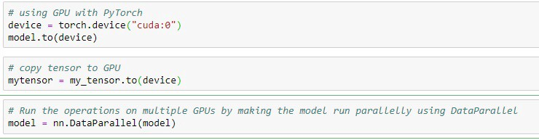
Pytorch
Python
Eager Execution
Widely used in research

Slide 5
Libraries
GPyTorch, combines Gaussian processes with DNN
BoTorch, Bayesian optimization
AllenNLP, open source NLP research library

Slide 6
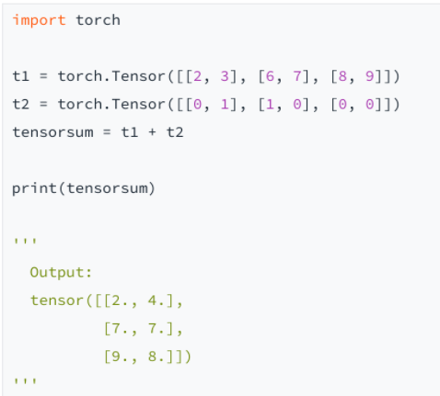
Notes:
sum of tensors using pytorch

Slide 7

TensorFlow
Python, Java, C++, Go
Static graph
Widely used at production level
Notes:
unlike pytorch, outline graph b4 running

Slide 8
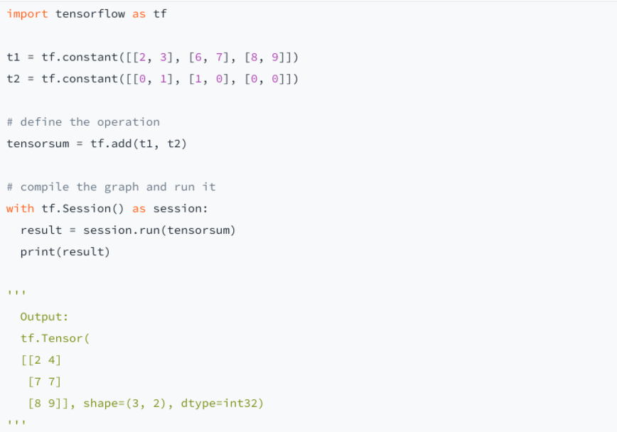
Python
TF.session.run ()
Notes:
sum of tensors using tensorflow

Slide 9
# Creates a graph.
with tf.device('/device:GPU:2'):
a = tf.constant([1.0, 2.0, 3.0, 4.0, 5.0, 6.0], shape=[2, 3], name='a')
b = tf.constant([1.0, 2.0, 3.0, 4.0, 5.0, 6.0], shape=[3, 2], name='b')
c = tf.matmul(a, b)
# Creates a session with log_device_placement set to True.
sess = tf.Session(config=tf.ConfigProto(log_device_placement=True))
# Runs the op.
print(sess.run(c))

Slide 10
Models
Computer Vision
Image Classification:
MNIST--Pattern recognition on real-world data
ResNet--Deep Residual Learning for Image Recognition
EfficientNet--Rethinking Model Scaling for Convolutional Neural Networks

Slide 11
Models
Computer Vision
Object Detection and Segmentation:
RetinaNet--Dense Object Detection
Mask R-CNN--Object instance segmentation
ShapeMask--Segment Novel Objects by Refining Shape Priors
SpineNet SpineNet--Scale-Permuted Backbone for Recognition and Localization

Slide 12
Models and Implementations
Natural Language Processing
ALBERT(A Lite BERT), BERT, NHNet, Transformer, XLNet

Slide 13
Brief summary of the evaluation
the advantages of Pytorch:
Pyrotch is easier to use
eager execution of TF
the chaos of TF API -- reduces the quality of tensorflow’s ecosystem

Slide 14
Brief summary of the evaluation
the disadvantages of Pytorch:
Ecological deployment is not so mature
well supprted in JetPack SDK
Pytoch 1.5 -- supprt C++

Slide 15
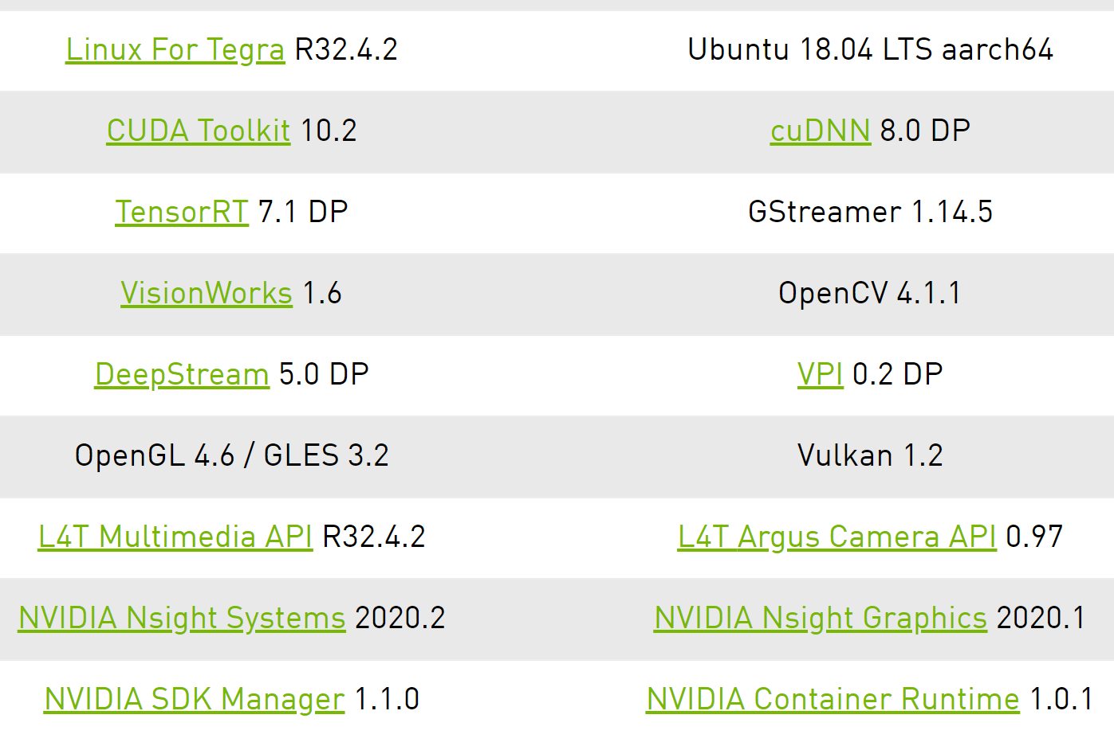
Components of JetPack SDK
It includes L4T together with accelerated software libraries, APIs, sample applications, developer tools, and documentation.

Slide 16
CUDA
Computer Unified Device Architecture
Parallel computing platform and API model
Allows usage of CUDA-enabled GPU
Gives direct access to GPU’s virtual instruction set, and parallel computational elements (for execution of compute kernels)
Can be used to work with C, C++, Fortran
CUDA 8.0 : cuBLAS, cuFFT, cuSPARSE,

Slide 17
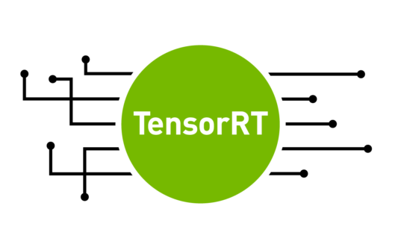
TensorRT
High performance inference optimizer can be used to perform inference in lower precision
INT8, FP16
40X faster than CPU inference
Notes:
https://developer.nvidia.com/tensorrt

Slide 18
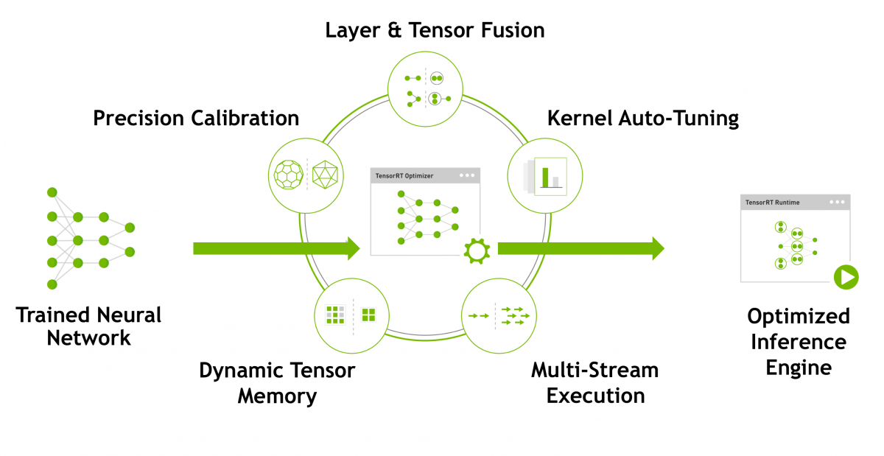

Slide 19
DeepStream
a streaming analytic toolkit to build AI-powered applications
function: converting pixels to insights
input streaming data from USB/CSI camera, video from file or streams over RTSP
uses AI and computer vision
generate insights for better understanding of the environment
applications

Slide 20
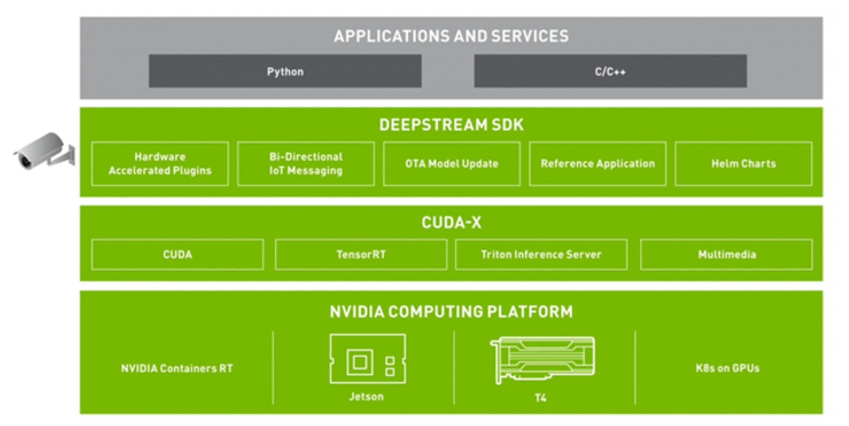

Slide 21
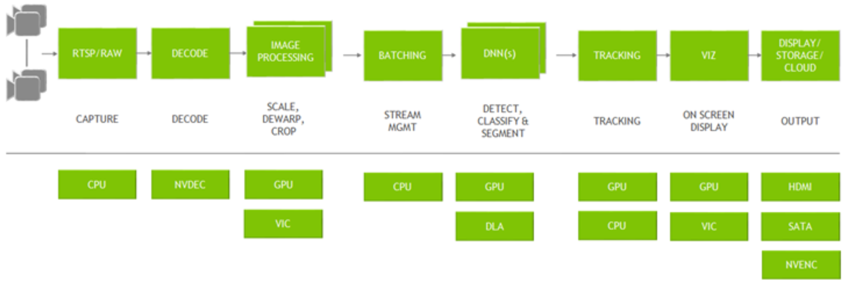
DeepStream graph architecture
provides building blocks in the form of GStreamer plugins that can be used to construct an efficient video analytic pipeline

Slide 22
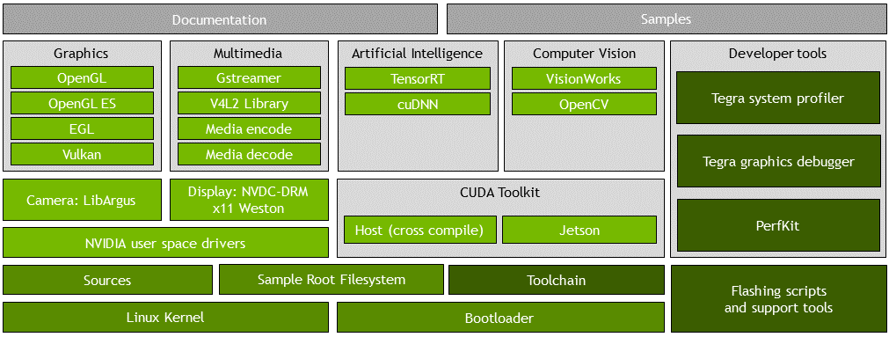
Other JetPack libraries

Slide 23
Other JetPack libraries
Graphics
OpenGL: Open Graphics Library API for rendering vector graphics.
OpenGL ES: Cross-platform API for full-function 2D and 3D graphics on embedded systems
EGL: Interface between Khronos rendering APIs such as OpenGL ES or OpenVG and the underlying native platform window system.
Vulkan: A low level API that gives direct access of the GPU to developers.

Slide 24
Other JetPack libraries
Multimedia API
a collection of lower-level APIs that support flexible application development
provides libraries, header files, API documentation and sample source code for developing embedded applications for the Jetson platform.
(MMAPI must be separately downloaded from the NVIDIA Jetson Download Center. It is not included in the download for the Jetson Driver.)

Slide 25
Other JetPack libraries
Developer Tools
Nsight Systems: Profiles application execution across multiple CPU cores. Helps you improve application performance by identifying slow parts of code.
NVIDIA® Nsight™ Compute: Interactively profiles kernel operations for CUDA applications.
Nsight Graphics: Debugs and profiles OpenGL and OpenGL ES graphics programs through a console interface.

Slide 26
Other JetPack libraries
Computer Vision
VisionWorks: NVIDIA® VisionWorks™ software development package for computer vision (CV) and image processing.
OpenCV: Provides OpenCV that NVIDIA optimized specifically for the Jetson platform.
Camera
libArgus: A low-level API based on the camera core stack.
Display
NVDC-DRM: NVIDIA userspace and driver for display.
X Driver: NVIDIA accelerated X driver.
Weston: NVIDIA accelerated Weston (compositor based on Wayland protocol).

Slide 27
Other JetPack libraries
Jetson Board Support Package
Linux Kernel: A UNIX-like computer operating system kernel mostly used for mobile devices.
Sample Root Filesystem derived from Ubuntu: A sample root filesystem of the Ubuntu distribution. Helps you create root filesystems for different configurations.
Toolchain: A set of development tools chained together by stages that runs on various architectures.
Bootloader: Boot software boot for initializing the system on the chip.
Sources: Source code for kernel and multimedia applications.
NVIDIA® Jetson™ User Space Drivers: Provides the NVIDIA drivers that run in the userspace.
Flashing Support Scripts and Tools: A set of scripts and associated tools to assist in flashing your system.
Sample Source Code and Applications: Sample source code for developing embedded applications for the Jetson platform.

Slide 28
Thanks

